Slide 1
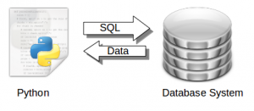
Lab 5 - Database Handling in Python Programming
Dr. Ohud Almutairi

Slide 2
Pre-requisite to connect Python with MySQL
Python 3: You can download and install Python from the official website (https://www.python.org/). Make sure to install the latest version of Python.
MySQL: You can download and install MySQL from the official website (https://www.mysql.com/). You will also need to create a database and set up a user with the appropriate permissions.
mysql-connector-python library: You can install this library using pip, the Python package manager. Open a terminal and run the following command:
pip install mysql-connector-python

Slide 3
Import the necessary module
Import the mysql.connector module to work with MySQL databases:
Syntax:
import mysql.connector

Slide 4
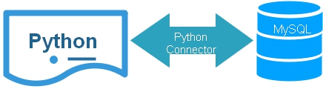
Establish a database connection
You can connect to your MySQL database using the connect() method, providing the necessary connection details like host, user, password, and database name:
Syntax:
db_connection = mysql.connector.connect(host="localhost", user="your_username", password="your_password", database="your_database")

Slide 5
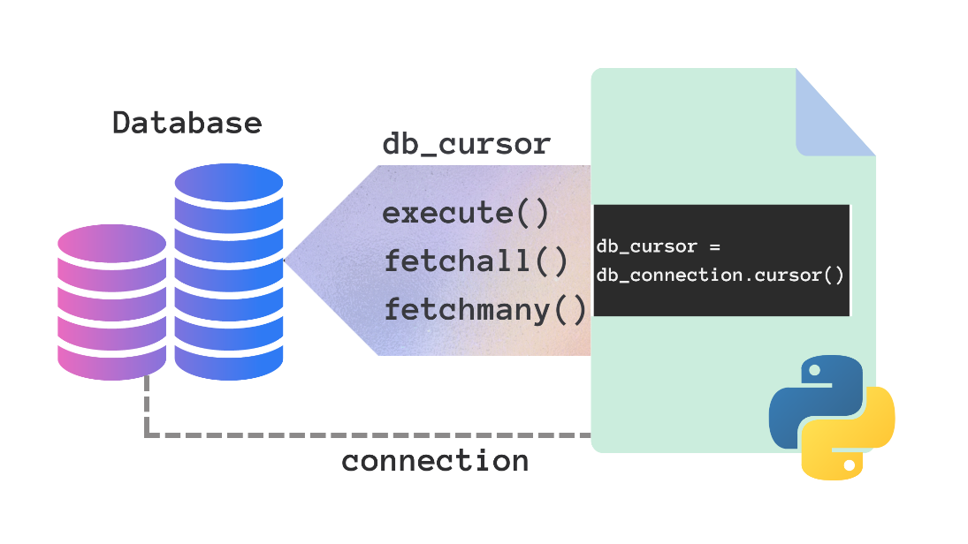
Create a cursor
Create a cursor to interact with the database:
Syntax:
cursor = db_connection.cursor()

Slide 6
Execute SQL queries
You can execute SQL queries using the execute() method of the cursor:
Syntax:
The following is example of executing some SQL queries
cursor.execute("CREATE DATABASE IF NOT EXISTS mydatabase")
print("Database 'mydatabase' created successfully")
cursor.execute("USE mydatabase")
create_table_query = """
CREATE TABLE IF NOT EXISTS employees(
id INT AUTO_INCREMENT PRIMARY KEY,
name VARCHAR(255),
age INT
) ""“
cursor.execute(create_table_query)

Slide 7
Execute SQL queries
Syntax:
The following is example of executing some SQL queries
insert_data_query = """
INSERT INTO employees(name, age) VALUES (%s, %s)
"""
employee_data = (“Mohammed", 25)
cursor.execute(insert_data_query, employee_data)
db_connection.commit()

Slide 8
Retrieve Data
You can fetch data from the database using fetchall(), fetchone() or fetchmany(n) methods of the cursor.
Syntax:
The following is example of fetching all employees from the table
cursor.execute("SELECT * FROM employees ")
employees = cursor.fetchall()
for employee in employees :
print("ID:", employee[0])
print("Name:", employee[1])
print("Age:", employee[2])

Slide 9
Update Data
You can update data in a MySQL table using execute() and commite() method of the cursor.
Syntax:
update_query = """
UPDATE employees
SET age = %s
WHERE name = %s
""“
new_age = 26
employee_name = “Mohammed"
cursor.execute(update_query, (new_age, employee_name))
db_connection.commit()

Slide 10
Close the Database Connection
It's crucial to close the database connection when you're done to free up resources.
Syntax:
if db_connection.is_connected():
db_connection.close()
print("Database connection closed")

